Slide 1
H1N1 Pandemic Influenza Planning Videoconference
August 13, 2009

Slide 2
Purpose of the Meeting
Terry L Dwelle MD MPHTM CPH FAAP

Slide 3
H1N1 Virus Overview
Terry L Dwelle MD MPHTM CPH FAAP
Notes:
It is a pleasure to be with you.
The purpose of this meeting is to address 4 areas including;
Define the situation
Describe the response plans
Discuss the roles of the various stakeholders in the response
Discuss fiscal implications.
Some of these areas are quite fluid and may change with new federal guidance or the unfolding of the epidemic.

Slide 4
Pandemic Influenza – General Information
Pandemic is a worldwide epidemic
We can expect several pandemics in the 21st century
Notes:
Some general statements on influenza include;
A pandemic is a worldwide epidemic.
Pandemics occur when there is essentially a great enough transition (antigenic shift) of an influenza virus to cause universal susceptibility (due to little cross reactive antibody from previous infections) thus worldwide transmission.
We can expect several pandemics in the 21st century. We had 3 pandmeics in the 20th century (1918, 1957, 1968).
We are currently in a WHO declared pandemic for H1N1 since it is a novel virus with broad susceptibility worldwide and is transmitted easily from human to human. We just don’t know the extent or impact of this virus over the next several months.

Slide 5
H1N1 (Swine Origin Influenza Virus)
33,902 cases in the US (estimate is that there have been 1 million cases in the US)
3663 hospitalizations (10.8%, 0.36% of estimated cases in the US)
170 deaths (0.5% of identified cases and 4.6% of those hospitalized, 0.017% of estimated cases in the US)
Genetically this H1N1 is linked to the 1918-19 strain
Currently we are seeing almost totally H1N1 circulating
Majority of the cases are in children and young adults
Majority of hospitalized patients have underlying conditions (asthma being the most common, others include chronic lung disease, DM, morbid obesity, neurocognitive problems in children and pregnancy).
There have been over 50 outbreaks in camps
Southern hemisphere – currently seeing substantial disease from H1N1 that is cocirculating with seasonal influenza. There has been some strain on the health systems in some situations.
About 30% of infected individuals are asymptomatic (study from Peru)
Notes:
As of July, 2009 we have the following information about H1N1;
33,902 cases in the US
3663 hospitalizations (10.8%, 0.36% of estimated cases in the US)
170 deaths (0.5% of identified cases and 4.6% of those hospitalized)
Seeing that we don’t know how many are mildly ill or asymptomatic (no definitive serologic studies yet) these rates are overestimates of hospitalizations and deaths.
Genetically this H1N1 is linked to the 1918-19 strain
Currently we are seeing almost totally H1N1 circulating
Majority of the cases are in children and young adults
Majority of hospitalized patients have underlying conditions (asthma being the most common, others include chronic lung disease, DM, morbid obesity, neurocognitive problems in children and pregnancy).
There have been over 50 outbreaks in camps
Southern hemisphere – currently seeing substantial disease from H1N1 that is cocirculating with seasonal influenza. There has been some strain on the health systems in some situations.
About 30% of infected individuals are asymptomatic (study from Peru)

Slide 6
H1N1 in Pregnancy
April 15 to May 18, 2009 – 34 confirmed or probable cases of H1N1 in pregnant women reported to the CDC
11/34 (32%) were admitted to hospital
General population hospitalization rate 7.6%
6 deaths – pneumonia and acute respiratory distress syndrome
Promptly treat pregnant women with H1N1 infection with antivirals
Lancet on line, July 29, 2009
Notes:
This is an article from July 29, 2009 on H1N1 in pregnancy.
April 15 to May 18, 2009 – 34 confirmed or probable cases of H1N1 in pregnant women reported to the CDC. These cases came from 13 states.
11/34 (32%) were admitted to hospital
General population hospitalization rate 7.6%
6 deaths – pneumonia and acute respiratory distress syndrome
This underlines the importance of promptly treating pregnant women with H1N1 infection with antivirals.
Pregnant women should also be immunized as a priority when the H1N1 vaccine is available.

Slide 7
Pandemic Influenza - Impact
A moderate pandemic may exceed the capacity of hospitals to provide inpatient care
Notes:
A moderate pandemic may exceed the capacity of hospitals to provide inpatient care. That’s why part of the states pandemic flu plan includes alternate care facilities like Long Term Care Facilities or even motels, gymnasiums etc.

Slide 8
Estimates of the Impact of an Influenza
ND estimates in parentheses
 | 1957 and 1968 | 1918
Illness | 90 million - 30% (160,000) | 90 million - 30% (160,000)
Outpatient medical care | 45 million - 50% (80,000) | 45 million - 50% (80,000)
Hospitalization | 865,000 (1600) – 1% | 9, 900,000 (19,200) – 12%
ICU care | 128,750 (256) – 0.16% | 1,485,000 (2880) – 1.8%
Mechanical ventilation | 64,875 (128) – 0.08% | 745,500 (1488) – 0.93%
Deaths | 209,000 (416) – 0.26% | 1,903,000 (3840) – 2.4%
Notes:
This slide just shows the estimated impact of an influenza using a few models and historical experience from the 1957 and 1968 and 1918 pandemics.
The illness rates could be the same at approximately 30% of the population. Remember pandemics infect individuals who are susceptible. In a pandemic essentially all people are susceptible.
The normal attack rate in an average seasonal flu may be around 15%.
Of interest a normal yearly attack rate for young children who are generally susceptible is 10-40% in the order of a pandemic with 1% requiring hospitalization. So yearly we have a microcosm of pandemic flu in the little people.
Outpatient medical care would be the same at 50% of the infected population.
It is estimated that hospitalization rates, mechanical ventilation and deaths would be approximately 10X higher with the 1918 variety vs 1957 and 1968 versions.
In ND in a 1918 scenario we could see as many as 19,200 hospitalized with 2880 in the ICU, with 1488 needing mechanical ventilation and 3800 deaths. This would be scattered over a 12 to 18 month period.
Notice that up to 160,000 people may become ill including many of your clinic and hospital support personnel. This needs to be considered in clinics planning for a pandemic, how to cover those critical roles due to illness.
This underlines why pandemic planning is important and some of the challenges in making estimates since the strain of the pandemic is critical in how this could unfold. A 1957 or 68 variety would result in much less hospitalization therefore require much less hospital resource vs the 1918 variety.
The current H1N1 seems to be acting much more like the 1957 or 1968 variety.
Some experts are concerned that this virus could become more virulent with subsequent waves. That has not happened in the southern hemisphere. They are currently in the midst of their winter flu season.

Slide 9
Pandemic Influenza - Epidemiology
Pandemics occur in waves
The order in which communities will be affected will likely be erratic
Some individuals will be asymptomatically infected
A person is most infectious just prior to symptom onset
Influenza is likely spread most efficiently by cough or sneeze droplets from an infected person to others within a 3 foot circumference
Notes:
Pandemics occur in waves. The first wave will likely last 4-8 weeks in each community followed by subsequent waves in weeks to months. These waves may occur up to 18 months or more for a pandemic strain. This fact demonstrates the problem of prophylaxis with antivirals. Pandemics are not a one time event. This fact also gives us time to develop a vaccine (6 months miniumum).
The order in which communities will be affected will likely be erratic often dependent of travel of infected individuals. A pandemic will not likely slowly move out across the state in a predictable pattern.
It is likely that the coasts of the US will be the first infected then moving out to cover the country. This was seen in the previous epidemics historically.
As with most respiratory viruses an infected person is most infectious just prior to symptom onset and with H1N1 is most contagious until 24 hours after the fever resolves without medications. This can be extended in the immunosuppressed and very young children.
Some individuals will be asymptomatically infected (probably 30% with H1N1). .
Influenza is likely spread most efficiently by cough or sneeze droplets from an infected person to others within a 3 foot circumference. Therefore covering a cough or wearing a mask when ill may decrease transmission by helping to contain the large droplets. We don’t know the efficacy of wearing surgical masks but it intuitively seems to make sense that their use would decrease transmission.
N95 masks are recommended for healthcare workers. The are some challenges with N95 nmasks. N95 masks require fit testing. N95 masks will not protect against eye contamination. No mask is effective with facial hair. N95’s are not recommended for the general public at this time.

Slide 10
Secondary Effects on Individuals and Communities
Individuals and Families
  Income / job security due to absenteeism
  Protecting children from exposure to influenza
  Continuity of education
  Fear, worry, stigma
  Access to essential goods and services (eg food, medication, etc.)
  Home-based healthcare
Communities
  Maintaining business continuity
  Sustaining critical infrastructures
  Availability of essential goods and services (supply chains)
  Supporting vulnerable populations
Notes:
There obviously are secondary effects of influenza on individuals and families.
This could and does happen during seasonal flu but potentially in a greater way in pandemics.
These factors relate to economics whether at the familiy or community business level, education, accessibility of essential goods and services are major concerns and are part of influenza planning efforts.

Slide 11
Pandemic Influenza - Response
We don’t look at pandemic flu as a separate disease to be dealt with in a different way from regular seasonal influenza
Influenza response toolbox
  Social distancing and infection control measure
  Vaccine
  Antiviral medications
The most effective way to prevent mortality is by social distancing
Notes:
In ND we don’t look at pandemic flu as a separate disease to be dealt with in a different way from regular seasonal influenza. The tools we use for seasonal flu and other transmissible respiratory pathogens will be the major tools we use in pandemic flu. The challenge is to ramp up the response and resources to meet the increased demands of a pandemic.
Every year we should be using and exercising the tools during regular influenza season that we will use during a pandemic so they become engrained as the way we respond. The tools for pandemic should not be different new or separate just because it’s a pandemic.
The Influenza response tools we have in our toolbox consist of the following;
Social distancing and infection control measure
Vaccine
Antiviral medications (medications to treat the infection to decrease the duration and severity of the illness)
The most effective way to prevent mortality is by social distancing.

Slide 12
Interventions
Intervention | Decrease in Attack Rates
Social distancing | 72%
Social distancing + Antiviral treatment | 72.6%
Social distancing + Antiviral treatment + Broad prophylaxis | 75.6%
Notes:
This slide shows the impact of various strategies on decreasing attack rates from pandemic flu. This chart was created via modeling and seems to be quite accurate.
Social distancing alone if done appropriately would decrease attack rates by 72%.
By adding antiviral treatment to social distancing there would be an additional 0.6% decrease in attack rates.
By adding broad prophylaxis of the general population to antiviral treatment and social distancing would add an additional 3% decrease in attack rates.
There are a few main messages here
Social distancing is the most effective tool we have to impact pandemic flu mortality rates.
Antiviral treatment or prophylaxis are not very good and for sure not the answer to pandemic flu.
Unfortunately much of the public feel that since our states have invested in antivirals stockpiles like Oseltamavir (Tamiflu) and Zanamavir (Relenza) that they are now safe.
Antivirals should not be considered the main response to pandemic flu.
Social distancing is the main tool in pandemic influenza.

Slide 13
Proxemics of Influenza Transmission
Residences
Offices
Hospitals
11.7 ft
Elementary Schools
7.8 ft
3.9 ft
16.2 ft
Notes:
This slide demonstrates the proxemics or spacial concerns of influenza transmission.
Most effective transmission occurs within a 3 foot radius of an infected person.
The closer individuals the greater the chance of transmission via infected droplets.
This comes from building data research.
This shows that in schools for young children (likely including day care centers) the interaction space is 3.9 ft vs 7.8 ft in hospitals, 11.7 ft in business offices and 16.2 ft in homes.
Colleges are probably somewhere in the hospital to residence areas therefore we consider higher ed facilities as regular communities.
This underlines the important concept of increasing the distance between people in all venues possible; spacing of chairs in the waiting room, location of people in offices, mass transportation seating arrangements etc.

Slide 14
Goals of Influenza Planning
Goals
Delay outbreak peak
Decompress peak burden on hospitals and infrastructure
Diminish overall cases and health impacts
Cases
Day
Notes:
This slide demonstrates a major goal of influenza response programs
Generally we seek to do the following;
Delay outbreak peak and
Decompress the peak burden on hospitals and infrastructure – or flatten the curve to stretch out the cases over a longer period of time to decrease the stress on our infrastructure.
And if possible to diminish overall cases and health impacts
Generally the only effective way to decrease the overall cases is by vaccination.
Without vaccination our other interventions like social distancing will likely not decrease the total number of cases but flatten the curve to allow our healthcare systems to appropriately respond.

Slide 15
Isolation
From www.cdc.gov/h1n1flu/guidance_homecare.htm
Data from 2009
  Most fevers lasted 2-4 days
  90% of household transmissions occurred within 5 days of onset of symptoms in the 1st case
  Requires 3-5 days of isolation (different from the 7 days previously used for influenza). The rule here is isolation for 24 hours after resolution of the fever without the use of fever-reducing medications.
  Consider closing a school or business for a minimum of 5 days which should move the infected into the area of much lower nasal shedding and contagion.
Notes:
This is info from the CDC based on H1N1 experience in the spring of 2009
Most fevers lasted 2-4 days
90% of household transmissions occurred within 5 days of onset of symptoms in the 1st case
CDC feels that isolation until 24 hours post resolution of the fever without the use of fever-reducing medications is adequate.
If the very rare situation of closing a school or business due to high attack rates a closure of 5 days should be adequate in most instances.
In home isolation a minimum period for isolation of the ill would be 3-5 days.

Slide 16
Stressed Hospital and Clinic Surge
Hosp / ILI
Clinic Caution 16.5
Clinic Crisis
21
Regional ILI rate
Notes:
The graph shows the caution level for clinics which is estimated to be 10% above current seasonal capacity. This assumes a normal seasonal influenza attack rate of 15%, therefore the clinic caution rate would be 16.5% or 10% above the normal seasonal flu estimates.
The hospital caution is rated at 80% of estimated surge capacity in a stressed state (the yellow line). The estimated stressed surge limit is designated by the red line.

Slide 17
Unstressed Hospital and Clinic Surge
North Dakota
Hosp / ILI
Clinic Caution 16.5
Clinic Crisis
21
X
Regional ILI rate
Notes:
The hospital caution is rated at 80% of estimated surge capacity in an unstressed state (the yellow line). The estimated unstressed surge limit is designated by the red line.
The X shows where I would suspect an aggressive H1 N1 season this fall. With a 1.5 – 2.0 % hospitalization rate of those with ILI and an ILI attack rate across the state of 30% we would still be beneath but close to the caution line of the current unstressed surge capacity of our hospitals. And well beneath the stressed hospital capacity.
Note also though that we would be well beyond the estimated clinic response capabilities therefore would likely need to use other clinic mitigation resources to meet the challenge (eg phone triage and pod antiviral distribution through the banks etc.)

Slide 18
Expected Response Roles
Tim Wiedrich, MS
Emergency Preparedness and Response

Slide 19
Epidemiology
TASK | STATE | LOCAL | TRIBAL
Surveillance | Primary | Secondary | None
Case identification and tracking | Primary | Secondary | None
Diagnosis confirmation | Primary | Secondary | None
Disease control recommendations | Primary | Secondary | None
Disease tracking | Primary | Secondary | None
Laboratory testing | Primary | None | None
Alerting | Primary | Primary | None

Slide 20
Isolation and Quarantine
TASK | STATE | LOCAL | TRIBAL
Implementation | Secondary | Primary | Primary
Monitoring | Secondary | Primary | Primary
Social need tracking | Secondary | Primary | Primary
Social needs met | Secondary | Primary | Primary
Mental health needs | Secondary | Primary | Primary

Slide 21
Mass Fatality Management
TASK | STATE | LOCAL | TRIBAL
Body collection | Secondary | Primary | Primary
Identification of dead | Secondary | Primary | Primary
Tracking and registration | Secondary | Primary | Primary
Alternative funeral management | Secondary | Primary | Primary
Body storage | Secondary | Primary | Primary

Slide 22
Medical Care
TASK | STATE | LOCAL | TRIBAL
Resource coordination (equipment and supplies) | Primary | Secondary | Secondary
Bed availability tracking | Primary | None | None
Personnel coordination | Primary | Secondary | Secondary
Training | Primary | Secondary | Secondary
Alternative care management (administrative/supply/support) | ? | ? | ?
Alternative care (patient care) | ? | ? | ?
Assistance with patient distribution | Primary | None | None
EMS management | Primary | None | None
Professional information and guidelines | Primary | None | None
Ethical decision making | Primary | Secondary | Secondary
Quality of care | Primary | None | None

Slide 23
Vaccine
TASK | STATE | LOCAL | TRIBAL
Receipt and Storage | Primary | None | None
Distribution | Primary | None | None
Monitoring | Primary | Secondary | Secondary
Vaccination of public (POD management) | Secondary | Primary | Secondary
Antiviral distribution | Primary | None | None

Slide 24
Public Information
TASK | STATE | LOCAL | TRIBAL
Education | Primary | Primary | Primary
Message development and coordination | Primary | Secondary | Secondary
Hotline management | Primary | Secondary | Secondary
Media briefing | Primary | Primary | Primary

Slide 25
Mental Health
TASK | STATE | LOCAL | TRIBAL
Coordination | Secondary | Primary | Primary
Stress counseling | Secondary | Primary | Primary
Grief counseling | Secondary | Primary | Primary
Health care worker support | Secondary | Primary | Primary
Support of I&Q | Secondary | Primary | Primary

Slide 26
Provision of Social Services
TASK | STATE | LOCAL | TRIBAL
Family assistance | Secondary | Primary | Primary
I&Q support | Secondary | Primary | Primary
Need tracking | Secondary | Primary | Primary
Coordination with federal response | Primary | None | Primary

Slide 27
Need Assessment
TASK | STATE | LOCAL | TRIBAL
Hospital and providers | Primary | Secondary | Secondary
General public | Secondary | Primary | Primary
Special needs public | Secondary | Primary | Primary

Slide 28
Information Coordination and Briefings
TASK | STATE | LOCAL | TRIBAL
Policymaker brief | Primary | Primary | Primary
Health care brief | Primary | Secondary | Secondary
Public health briefing | Primary | Secondary | Secondary
Command and control | Primary | Primary | Primary

Slide 29
Policy Development and Implementation
TASK | STATE | LOCAL | TRIBAL
Social distancing | Primary | ? | Primary
Resource allocation | Primary | Secondary | Secondary
Isolation and quarantine | Primary | Primary | Primary
Anti-viral and vaccine use | Primary | None | Primary
Quality of care standards | Primary | Primary | Primary
Alternative care site use | ? | ? | ?
School closure | Primary | ? | Primary
Worker protection | Primary | Primary | Primary
Fatality management | Primary | Primary | Primary

Slide 30
Continuity of Operation (COOP)
TASK | STATE | LOCAL | TRIBAL
Plan development | Primary | Primary | Primary
Pre-identified resources | Primary | Primary | Primary
Pre-identified core roles | Primary | Primary | Primary
Essential services documented | Primary | Primary | Primary
Facility identification | Primary | Primary | Primary
Tactical communications | Primary | Primary | Primary

Slide 31
Pan Flu Antivirals
Terry L Dwelle MD MPTHM CPH FAAP
Notes:
A few comments about antivirals.

Slide 32
Intervention - Antivirals
Antivirals (Tamiflu and Relenza) will be used primarily for treatment not prophylaxis
  ND will have approximately 160,000 treatment courses available for a pandemic (25% of the population)
Distribution flow
  Normal
  Normal + Supplementation (from the state cache, some prepositioned with LPHU’s)
  Points of Distribution
Resistance is a major concern
Notes:
Antivirals likeTamiflu and Relenza will be used primarily for treatment not prophylaxis
One of the roles of the HD is to provide the tools you clinicians need to take care of clinically ill patients. Clinicians will need to diagnose those needing antivirals.
ND will have approximately 160,000 treatment courses available for a pandemic (to cover 25% of the population)
The distribution of antivirals will be through three mechanisms that build upon each other.
Normal – pharmacies order from wholesale pharmaceutical provider
With a taxing of the normal supplies direct supplementation from the state cache will be implemented.
Some antivirals prepositioned at the LPHU’s to help with this supplementation.
Pharmacies can order supplementation antivirals through the HAN ordering system.
If clinics and pharmacies are overwhelmed then a phone triage system with points of distribution (eg banks etc) will be implemented.
Antiviral resistance is a major concern. Some strains of avian and H1N1 influenza have developed some resistance to Tamiflu.

Slide 33
Prophylaxis
High risk when significantly exposed
Non-immunized close contacts of a case
Occasional control of outbreaks in a high risk (closed) institutional setting
Notes:
Prophylaxis though not a major strategy is left to the judgment of the clinician.
This just lists some major situations where prophylaxis could be considered including;
High risk when significantly exposed
Non-immunized close contacts of a case
Occasional control of outbreaks in a high risk (closed) institutional setting

Slide 34
Social Distancing and Infection Control
Kirby Kruger, State Epidemiologist, Division Director
of Disease Control
Notes:
A few comments about antivirals.

Slide 35
Outline INFLUENZA
Disease
Novel H1N1
Mitigation
Surveillance in ND

Slide 36

Each Year in the US…
On average:
  36,000 people die from the flu
  More than 200,000 people are hospitalized from flu complications
  There are ≈ 25 million physician visits
  And ≈15 to 60 million infections
  (5% to 20% of the population)
Notes:
Key Messages
Influenza imposes a heavy disease burden on US society in an average year⁴
The number of influenza-related deaths has increased significantly in the past decade and is estimated to continue to increase as the population continues to age⁴
The number of pneumonia and influenza deaths increased by 83% from the 1976-1977 through 1997-1998 influenza seasons
From the 1990-1991 through 1998-1999 seasons, there was an annual average of approximately 82,000 underlying pneumonia and influenza deaths
People aged ≥85 years are 32 times more likely to die from influenza or influenza-associated pneumonia than people aged 65 to 69 years
Annual hospitalizations for respiratory and circulatory conditions associated with influenza virus infection have been estimated at 294,128 (range of 86,494 to 544,909)⁵
Influenza results in an average of 25 million healthcare visits annually in the US²
The annual estimated economic losses due to influenza are $3 to $5 billion⁶
References
CDC. Influenza fact sheet. Available at: http://www.cdc.gov/flu/keyfacts.htm. Accessed May 24, 2007.
Couch RB. Influenza: prospects for control. Ann Intern Med. 2000;133:992-998.
U.S. Census Bureau. Available at: http://www.census.gov/main/www/popclock.html. Accessed May 24, 2007.
Thompson WW, Shay DK, Weintraub E, et al. Mortality associated with influenza and respiratory syncytial virus in the United States. JAMA. 2003;289:179-186.
Thompson WW, Shay DK, Weintraub E, et al. Influenza-associated hospitalizations in the United States. JAMA. 2004:292:1333-1340.
Patriarca PA. New options for prevention and control of influenza. JAMA. 1999;282:75-77.

Slide 37
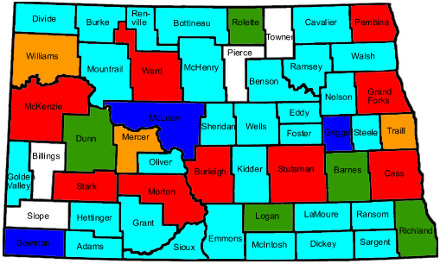
Influenza in North Dakota
Each season:
  Approximately 400 people die
  from Pneumonia and Influenza
  On average 2,300 influenza cases are reported to the health department
    Using CDC estimates ≈ 3,000 to 128,000 infections
    2008-2009 season there were more than 1,600 cases reported to the health department

Slide 38
Surveillance
Laboratory Surveillance
Sentinel Physicians
Syndromic Surveillance
Follow-up of random sample of children under the age of 18
School absenteeism reports
Outbreak Support

Slide 39
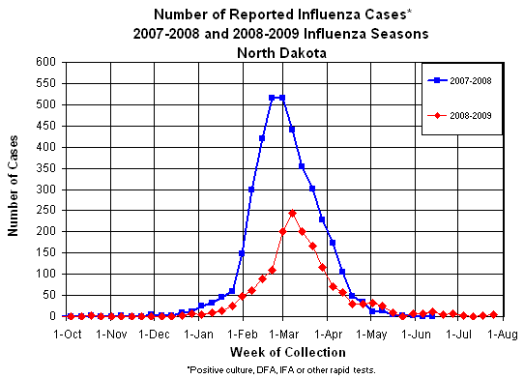
07-08 and 08-09 Flu Seasons
Notes:
Predicting peaks and numbers are difficult.

Slide 40
Influenza Mortality/Morbidity
Influenza-related deaths among children is uncommon
  Typically over 90% of the P&I deaths in ND are in those ≥ 65 years of age
Children represent a substantial portion of influenza morbidity in the state

Slide 41
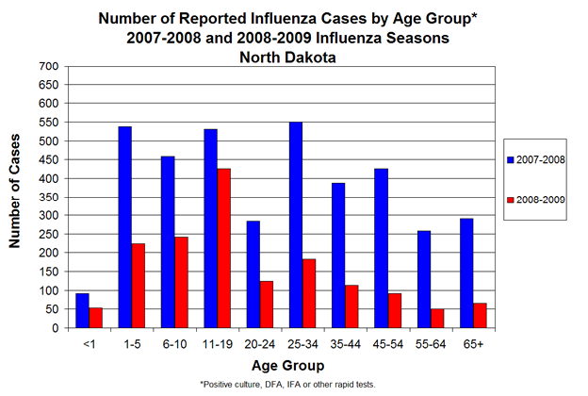
Flu Cases by Age Group

Slide 42
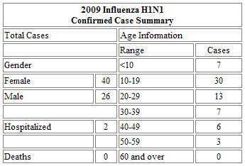
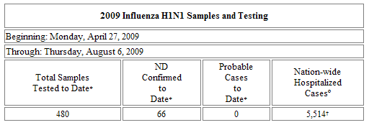
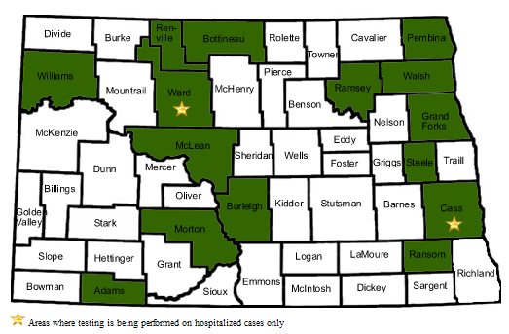
What have we seen in ND?

Slide 43
Community Mitigation
Schools
Childcare settings
Healthcare settings
Businesses
General Public
Home care

Slide 44
Community Mitigation
Isolation or exclusion
  Voluntary and passive
  24 hours after fever subsides and not using fever reducing medication
Hand hygiene
Respiratory etiquette

Slide 45
Exclusion Period - time ill people should be away from others
Applies to settings in which the majority of the people are not at increased risk for complications
In general - for the general public
Does NOT apply to health care settings
  Staff
  Visitors
Antivirals do not interfere with exclusion

Slide 46
Schools
Under conditions seen this spring (current conditions) the goal will be to keep schools open and reduce disease transmission as much as possible
Under conditions of increased severity compared to spring of 2009

Slide 47
Schools Current Conditions
Ill staff and students to stay home
  Fever of ≥ 100° F with cough and/or sore throat
Ill staff and students to be separated from others while waiting to go home
  Proper infection control for staff that are caring for ill students
Hand hygiene and respiratory etiquette
Routine Cleaning
Early treatment of high risk individuals
Consideration of selective school dismissal

Slide 48
Schools – more severe conditons
Active Screening
High risk students and staff stay home
Quarantine if household members are sick
Increase distance between people at school
Extend isolation periods - use 7 day period or 24 hours after fever, whichever is longer
School dismissal
  Reactive
  Preemptive

Slide 49
Childcare Settings
Guidance still under revision
Similar to schools
For settings with very young children (< 5 years)
  Consideration the longer exclusion period

Slide 50
Infection Control
Healthcare Facilities
CDC still recommending airborne precautions (N95) with all encounters with patients with ILI
HICPAC
  Has endorsed standard precautions plus droplet precautions
WHO – same as HICPAC
NDDoH Similar to HICPAC and WHO

Slide 51
Businesses
Review or develop business continuity plans
Provide education for employees
Promote vaccination
Review leave policies with employees
  Non-punitive
Encourage sick employees to stay home
Promote hand hygiene and respiratory etiquette
Increase distances between employees and employees and the public
Implement telecommuting and staggered shifts if possible

Slide 52
General Public
Hand hygiene and respiratory etiquette
Avoiding large public gatherings
Stay home while ill with a fever
Seek medical care or treatment if indicated
  High risk group
  Signs of more severe illness
Prepare to be at home for 7-10 days
How to care for ill family members
Infection control in the home

Slide 53
Homecare
Infection control
Drink plenty of clear fluids
OTC medications (no aspirin)
Monitor fever and other symptoms
When to seek medical care
  Difficulty breathing or chest pain
  Purple or blue color in lips
  Severe vomiting
  Signs of dehydration (dizzy, low urine output, no tears, loss of elasticity in skin)
  Less responsive than usual or confusion

Slide 54
Infection Control in the Home
Place ill person in a private room try to designate one bathroom for ill person
Have ill person wear a surgical mask
No visitors
One non-pregnant person should provide care
Caregiver should consider wearing mask
Caregiver should consider N95 if assisting with respiratory treatment
Hand hygiene and respiratory etiquette for household
Use paper towels to dry hands

Slide 55

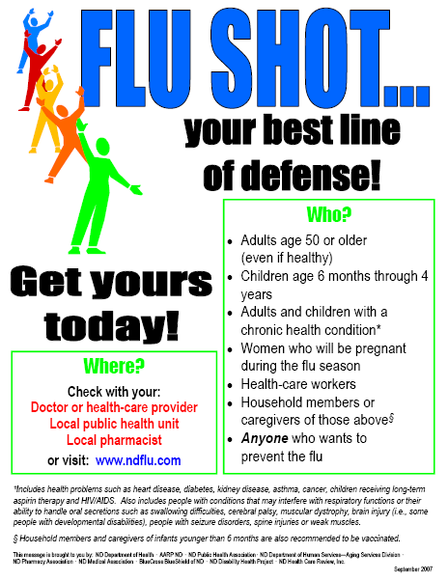
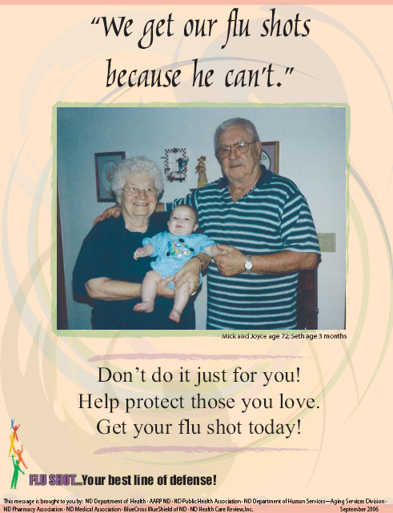



Public Education

Slide 56
Break

Slide 57
Surveillance and Reporting
Kirby Kruger, State Epidemiologist, Division Director
of Disease Control
Notes:
A few comments about antivirals.

Slide 58
Surveillance
Laboratory Surveillance
Sentinel Physicians
Syndromic Surveillance
Follow-up of random sample of children under the age of 18
School absenteeism reports
Outbreak Support

Slide 59
Surveillance
Laboratory Surveillance
  Increase number of laboratories reporting
Sentinel Physicians
  Increase the number of sentinel physicians
Syndromic Surveillance
  Monitor ER visits more closely
Follow-up of all children under the age of 25
  Mail-out survey forms to all reported cases

Slide 60
Surveillance
Hospitalizations
  Work with Infection Control Nurses
  Participate in the Emerging Infections Program
  Use of RedBat to gather Hospitalization data
  Use of HC Standard
School absenteeism rates
  Increase the number of schools that report
  Monitor school closures

Slide 61
Surveillance
Outbreak Support
  Increase the number of facilities that can report outbreaks and receive free testing

Slide 62
Surveillance
Local public health can help by
  Staying aware of community situation
  Reporting clusters of illness to the state
  Reporting increased absenteeism at schools
  Working with the state and with schools or community on interventions

Slide 63
Resources
NDDoH flu web-page (updated every Wednesday)
  http://www.ndflu.com/
MMWR – Prevention and Control of Influenza, Recommendations of the Advisory Committee on Immunization Practices (ACIP), 2008
  http://www.cdc.gov/mmwr/preview/mmwrhtml/rr57e717a1.htm
CDC flu web-page
  http://www.cdc.gov/flu/

Slide 64
Vaccination Strategy
Molly Sander, MPH
Immunization Program Manager

Slide 65
Vaccine
Separate novel H1N1 influenza vaccine from seasonal trivalent vaccine.
Five manufacturers: same age indication as seasonal vaccine.
  Novartis (45.7%): multi-dose vials
  Sanofi (26.4%): multi-dose vials and pediatric preservative free syringes
  GSK (3.4%): multi-dose vials
  CSL (18.7%): multi-dose vials and preservative free syringes
  Medimmune (5.8%): nasal sprayers
Notes:
Flumist: rumors about lack of enough nasal sprayers, may have to use droppers

Slide 66
Vaccine
Storage and handling: same as seasonal vaccine
  35 – 46 degrees Fahrenheit
  2 – 8 degrees Celsius
FDA approval: strain change, same as seasonal influenza vaccine
  Unlikely to use adjuvanted vaccine
Assume 2 doses required, separated by 3 to 4 weeks
  Patients should be informed about the need for a subsequent dose.
Administer seasonal vaccine at the same time.
Notes:
Canada using adjuvant

Slide 67
Contraindications and Precautions
Most likely the same as seasonal influenza vaccine
Inactivated:
  Anaphylactic allergy to eggs or other component in the vaccine.
  Moderate to severe acute febrile illness (defer vaccination until recovered).
  Guillain-Barre Syndrome (GBS) 6 weeks following previous dose (precaution).

Slide 68
Contraindications and Precautions
LAIV:
  persons with a history of hypersensitivity, including anaphylaxis, to any of the components of LAIV or to eggs.
  persons aged <2 years or those aged 50 years and older;
  adults and children who have chronic pulmonary (including asthma), cardiovascular (except hypertension), renal, hepatic, neurological/neuromuscular, hematological, or metabolic disorders (including diabetes mellitus);
  adults and children who have immunosuppression (including immunosuppression caused by medications or by HIV);
  children aged 2 – 4 years whose parents or caregivers report that a health-care provider has told them during the preceding 12 months that their child had wheezing or asthma, or whose medical record indicates a wheezing episode has occurred during the preceding 12 months;
  children or adolescents aged 6 months – 18 years receiving aspirin or other salicylates (because of the association of Reye syndrome with wild-type influenza virus infection); or
  pregnant women.

Slide 69
Availability
Estimated availability (as reported at the July ACIP meeting):
  40 million doses in September (if decision to vaccinate early)
  120 million doses in October
    Followed by 80 million doses/month after

Slide 70
ACIP Recommendations
Pregnant women because they are at higher risk of complications and can potentially provide protection to infants who cannot be vaccinated;
Household contacts and caregivers for children younger than 6 months of age because younger infants are at higher risk of influenza-related complications and cannot be vaccinated. Vaccination of those in close contact with infants less than 6 months old might help protect infants by “cocooning” them from the virus;

Slide 71
ACIP Recommendations
Healthcare and emergency medical services personnel because infections among healthcare workers have been reported and this can be a potential source of infection for vulnerable patients. Also, increased absenteeism in this population could reduce healthcare system capacity;
  Include public health personnel
Notes:
See 2006 ACIP recommendations for healthcare personnel
In this report, the term HCP refers to all paid and unpaid persons working in
health-care settings who have the potential for exposure to infectious materials,
including body substances, contaminated medical supplies and equipment,
contaminated environmental surfaces, or contaminated air. HCP might include
(but are not limited to) physicians, nurses, nursing assistants, therapists,
technicians, emergency medical service personnel, dental personnel, pharmacists,
laboratory personnel, autopsy personnel, students and trainees, contractual staff
not employed by the health-care facility, and persons (e.g., clerical, dietary,
housekeeping, maintenance, and volunteers) not directly involved in patient
care but potentially exposed to infectious agents that can be transmitted to and
from HCP. The recommendations in this report apply to HCP in acute care
hospitals, nursing homes, skilled nursing facilities, physician’s offices, urgent
care centers, and outpatient clinics, and to persons who provide home health
care and emergency medical services.

Slide 72
ACIP Recommendations
All people from 6 months through 24 years of age
  Children from 6 months through 18 years of age because many cases of novel H1N1 influenza are in children and they are in close contact with each other in school and day care settings, which increases the likelihood of disease spread, and
  Young adults 19 through 24 years of age because many cases of novel H1N1 influenza are in these healthy young adults and they often live, work, and study in close proximity, and they are a frequently mobile population; and,

Slide 73
ACIP Recommendations
Persons aged 25 through 64 years who have health conditions associated with higher risk of medical complications from influenza.
  Chronic pulmonary disease, including asthma
  Cardiovascular disease
  Renal, hepatic, neurological/neuromuscular, or hematologic disorders
  Immunosuppresion
  Metabolic disorders, including diabetes mellitus

Slide 74
ACIP Recommendations
Once the demand for vaccine for the prioritized groups has been met at the local level, programs and providers should also begin vaccinating everyone from the ages of 25 through 64 years.
Current studies indicate that the risk for infection among persons age 65 or older is less than the risk for younger age groups. However, once vaccine demand among younger age groups has been met, programs and providers should offer vaccination to people 65 or older.

Slide 75
ACIP Recommendations
If demand exceeds supply (not expected):
  pregnant women,
  people who live with or care for children younger than 6 months of age,
  health care and emergency medical services personnel with direct patient contact,
  children 6 months through 4 years of age, and
  children 5 through 18 years of age who have chronic medical conditions.

Slide 76
Distribution
H1N1 vaccine purchased from manufacturers by the federal government.
Vaccine is allocated to states based on population.
  Separate allocation for active military.
  Allocation includes IHS.
  ND should receive 0.208% of vaccine supply.
H1N1 vaccine will be distributed through a third party distributor (McKesson)
  Same distributor as Vaccines For Children (VFC) vaccine.
Notes:
Will there be a separate allocation for DoD dependants, retirees and civilian employees?
There is no separate allocation for these groups. Military facilities may be willing to vaccinate these groups, but will need to be allocated vaccine for these populations by the project areas.

Slide 77
Distribution
McKesson will distribute vaccine based on orders received from the state through CDC’s ordering system, VACMAN.
McKesson will ship vaccine and ancillary supplies.
  Needles, syringes, sharps containers, alcohol wipes, etc.
  H1N1 vaccination card.
Minimum number of doses per order is 100.
  Increments of 100.

Slide 78
Distribution
McKesson will report doses shipped to the NDDoH.
  Electronically transferred to inventories in NDIIS.
Unlimited number of sites for vaccine to be shipped to in North Dakota.
Providers should check cold storage capabilities.
  What is the maximum amount of storage available during seasonal influenza vaccination?

Slide 79
Enrollment
Providers are required to sign an enrollment form in order to receive H1N1 vaccine.
  CDC is creating a standardized form. It is currently unavailable.
Enrollment requirements unknown, but most likely include:
  Proper storage and handling
  Following of ACIP recommendations
  Reporting of doses administered?

Slide 80
Administration Fee
The federal government will set a maximum administration fee.
  Most likely at the Medicare rate: $18.45/dose in North Dakota. (Different than Medicaid fee cap for VFC:$13.90)
Administration fee may be billed to patient, Medicaid, Medicare, private insurance, etc.
Local public health units cannot refuse to vaccinate based on inability to pay.
  Private providers will probably be able to refuse vaccination if patient is unable to pay.

Slide 81
NDIIS
The North Dakota Immunization Information System (NDIIS) will be used to track doses administered.
  Similar data entry to other vaccines, but includes high-risk groups for vaccination.
  Exploring the possibility of scanning.
Doses administered must be reported to CDC by the state on a weekly basis.
  Report each Tuesday for the previous week.

Slide 82
NDIIS
Ability to run reports to determine who needs second dose vaccination.
  Reminder/Recall conducted by NDDoH.
Must have username and password to access the NDIIS.
Contact the NDDoH at 701.328.3386 or toll-free at 800.472.2180 if interested in obtaining access.
Trainings are being scheduled for the NDIIS.
Notes:
Reminder/recall at the state?

Slide 83
VAERS
Vaccine adverse events should be reported to the NDDoH.
Forms available at: http://vaers.hhs.gov/ or through the NDDoH Immunization Program.
VAERS module will be available in NDIIS.
  Same fields as VAERS form.
  Pre-populated with demographic and vaccine information from NDIIS.

Slide 84
Forms
Vaccine Information Statements (VIS):
  Providers must provide a VIS with each dose of vaccine administered.
  VIS for H1N1 is currently in development.
  VIS will be supplied by the NDDoH.
Vaccine Administration Record (VAR):
  H1N1 VAR being created by NDDoH.

Slide 85
Authority to Vaccinate
Local public health units
Private providers
Pharmacists may vaccinate adults
EMTs may vaccinate adults against influenza
Parental signature for vaccination is not required in North Dakota. A parent presenting to a clinic with a child is considered consent.

Slide 86
Strategies for Vaccination
Mass Immunization Clinics
School Clinics:
  See draft school letter about vaccination clinics.
  CDC is creating an advanced consent form.
  CDC is encouraging school clinics.
Vaccination similar to seasonal influenza vaccination.
See H1N1 Vaccination Campaign Planning Checklist.

Slide 87
Seasonal Influenza Vaccination
May be started when vaccine is available.
ACIP recommendations published and available at: http://www.cdc.gov/mmwr/preview/mmwrhtml/rr5808a1.htm?s_cid=rr5808a1_e.
  No changes from last season.
Some private vaccine has already shipped.
VIS currently unavailable, use last year’s if starting to vaccinate.

Slide 91
Pneumococcal Vaccination
The ACIP recommends that persons recommended for pneumococcal vaccine receive it in light of the potential for increased risk of pneumococcal disease associated with influenza.
There are at present no recommendations to give pneumococcal vaccine to groups for whom it is not currently recommended.
ACIP will revisit this question over the summer as epidemiologic data from the Southern hemisphere influenza season and from the U.S. become available.

Slide 92
For more information visit: http://www.cdc.gov/h1n1flu/vaccination/statelocal/

Slide 93
Contact Information
Molly Sander, MPH, Program Manager 328-4556
Abbi Pierce, MPH, Surveillance Coordinator 328-3324
Keith LoMurray, 328.2404
IIS Sentinel Site Coordinator
Tatia Hardy, VFC Coordinator 328-2035
Kim Weis, MPH, AFIX Coordinator 328-2385

Slide 94
Laboratory
Mike Trythall,
Laboratory Services

Slide 95

Questions and Answers

