Slide 1
Using Social Media in Evaluation
Learning the basics and Preparing yourself to successfully Plan and measure your social media platforms
Notes:
Welcome to part 1 of 3 our training on Social Media in Evaluation. My name is Dan Goldstein, and I am the Marketing & Communications Assistant at The Improve Group.
As Social Media is growing and becoming part of the fabric of our society, it has become an essential element of how organizations engage with communities.
The goal of this 3-part training is to arm you with a basic understanding of social media platforms, provide the tools to conduct basic analysis of social media activity, and show you how to create a social media plan for marketing your events.
This brings us to our agenda for the day.

Slide 2
Agenda
Part 1 – Social Media Basics & Tools
  Social Media Platforms
  Social Media for Analysis
  Useful Tools
Part 2 – Analyzing Social Media Activity
  Defining your Baseline
  Measuring your activity
  Measuring your impact on attitudes
Part 3 – Designing your Social Media for Success
  Creating a Measurable Social Media Strategy for your Events
  Engaging your Audience through Social Media During an Event
  Following up After an Event has Finished
Notes:
You are watching part 1 of this three part training series.
In part 1, we are going to talk about Social Media Basics & Tools
In part 2, we will talk about Analyzing social media activity; and
In part 3, we will be designing your social media for success

Slide 3
Part 1 – Social Media Basics & Tools
Agenda
Social Media Platforms
  Facebook, Twitter, Instagram, YouTube, Snapchat, Pinterest, Live Streaming, LinkedIn
Social Media for Analysis
  Which social media platforms are best for analyzing your activities?
Tools for Optimization
  Tools that will help you schedule posts across multiple platforms in one place
Notes:
Here is our agenda for part 1 of the training. First we will look at the most popular social media platforms used in America today. This includes Facebook, Twitter, YouTube, Instagram, Snapchat, and Pinterest and Live Streaming. For each platform, we will explain what it is, how to use it, and the pros and cons of using each.
For each platform, we will also highlight whether analysis of your posts are supported by the tools that the platform provides.
Finally, part 1 will conclude with details about online tools that help you optimize and track your social media content, as well as tips and tricks for using each.
Before we begin, I want to give you a bit of background on why social media is so important to your organization…

Slide 4
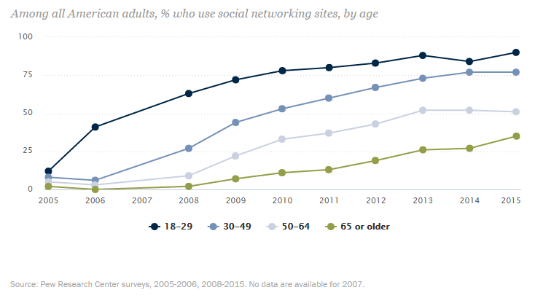
Social Media Basics
What is Social Media & Why Should I Use it?
Notes:
(time in video: 1:30-2:43)
Social media are online platforms that facilitate the sharing of information, ideas, career interests and other forms of expression through virtual communities and networks.
Social media use web-based and mobile technologies to create highly interactive platforms where individuals, communities and organizations can share, co-create, discuss, and modify user-generated content or pre-made content posted online. To put it in laymen's terms, social media platforms allow you to build an online profile for you or your organization, where you can engage with the world.
That sounds great, but it still doesn’t answer the question of why social media is so essential for your organization. While there are many answers to this question, the most simple response is this: Approximately 2.1 billion people have social media accounts, and nearly 1.7 billion people are active daily users (as of May 2016). And as time goes on, this number continues to grow.
This table from Pew Research Center demonstrates the percentage of American adults who use social media by age from 2005 to 2015.
Social Media is Essential to your Organization because it allows you to:
Build relationships with your community
Keep your stakeholders engaged with you, and updated on news/events
Drive traffic to and build credibility for your content; and
Reach an audience you may not have been able to reach previously
By building your social media presence, your organization and the impact you are making will experience continued growth and sustainability.
*Social Media Statistics: http://www.pewinternet.org/2015/10/08/social-networking-usage-2005-2015/

Slide 5
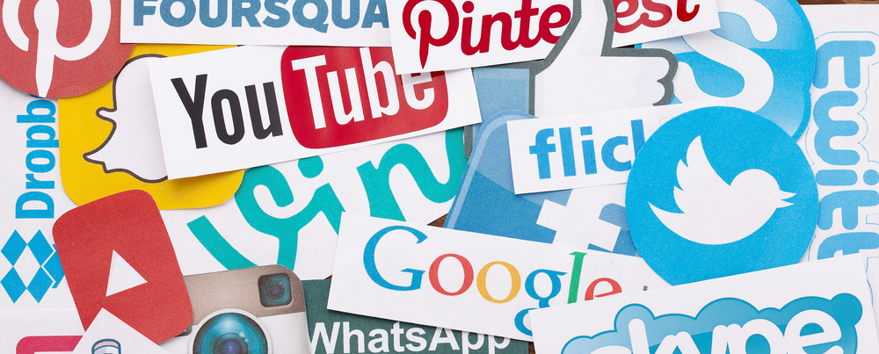
Social Media Platforms
What social media channels are out there and how can they be used?
Notes:
(time in video: 2:43-3:10)
In this next section, we will cover some basic information about each of the prominent social media platforms today.
By learning more about what each platform is, and how you can use it, you will be able to make an informed decision on whether each platform is relevant to your organization and worth the investment of time and other resources.
First we will start with the world’s most popular social media platform: Facebook

Slide 6

Facebook
  What is Facebook?
    Largest social media platform in the world
    Offers personal “profile” and business “page”
    Follow others from your “News Feed”
  How do I use it?
    Post, like, comment, share, follow
  Pros
    Loyal fans; personal connections; reach can become wide-spread; you can better promote events; in-depth analytics
  Cons
    Time commitment; slow burn; that darn algorithm!
http://www.facebook.com
Notes:
Facebook: 3:10 – 14:16
Facebook is the world’s largest social media platform with over 1.7 billion active accounts. In fact, it is not just the most popular social media platform, but its also the most visited web page in the world.
So what is Facebook? (3:10 – 4:57)
Facebook allows you to create a personal profile to connect with your family and friends and share updates about your lives online. Through your Facebook profile, you can share limitless amounts of photos, videos, and status updates about anything you would like. Once these items have been shared, your friends have the ability to engage with you by liking, commenting, or sharing your posts with others.
In addition to creating your own profile, Facebook also allows you to create a “page.” Pages are for brands, businesses, organizations and public figures to create a presence on Facebook, whereas “profiles” represent individual people.
Anyone with a Facebook profile can create a Page or help manage one. Once your “page” has been created, you can begin sharing updates as an organization. As people begin to notice your organization, they may chose to ‘like’ and ‘follow’ it from their personal profile. People who ‘like’ your page are showing their support for your organization. Once they chose to like your page, they will then be subscribed to ‘following’ your Page which means they will get your updates delivered to their News Feed. However, people may chose to like your page, but unfollow your posts in the future, meaning they would have to navigate to your page in order to see them. Conversely, people who like your page can also chose to ‘see your posts first’ when they follow you, meaning all of your posts will appear on their timeline. This is a much more important feat than obtaining a page like
The News Feed is the constantly updating list of stories in the middle of your home page. News Feed includes status updates, photos, videos, links, app activity and likes from people, Pages and groups that you follow on Facebook.
How do I use it? (4:58 – 8:17)
Now that you know what Facebook is, lets take a look at it. [Transition to Facebook News Feed]
This is my own personal News Feed. Right at the top, you can see a question from Facebook that says “What’s on your mind?” This is where you go to share an update, known as a “Post.” As I click this box, you can see that it becomes highlighted, and I can now begin typing. At the top, you can see the options of “Photo/Video” and “Photo/Video Album.” By clicking these buttons, I can bring in a photo or video, or several photos and videos to accompany my post. Once I have finished typing and attaching content, I can click “Post” and it will then be shared with all of my friends.
As I scroll down my News Feed, you can see the numerous status updates that my Facebook friends are sharing. Its important to note that these are not the Posts from all of my friends in chronological order. Facebook uses an algorithm to determine who’s posts you see most on your News Feed – this algorithm is based on your Facebook activity. The more times that you visit a friend’s profile, or like a certain Friend’s Posts – the more likely that person’s posts will show up in your News Feed in the future.
As I scroll on to a status update that catches my attention, I can interact with it by liking, commenting, or sharing. If someone has shared something that resonates with me, I can let them know with a “Like” by clicking the thumbs up symbol in their update. As I hover my mouse over this button, an additional menu pops up, and I am also given more options to react to the post – “Love” “Laugh” be “Surprised”, “Sadness” and “Anger.” You may chose to react to a person however you like – once you do, that person is given a notification about your reaction.
Under this status is the comment bar – here I can write a personal message to the person and say whatever I want! The comment section is what makes Facebook so engaging.
Finally, I can click the “Share” button. This will allow me to share this person’s status update to my own profile. Once an update has been shared to my profile, then any of my friends have the ability to see this post.
Scrolling back to the top, I want to highlight a few more basics about navigating and using Facebook. Up in the top right of my menu, you will notice three icons – 2 people, a message box, and a globe. When you click the icon that looks like 2 people, a drop down menu will appear that will show you people that you may know and who you may want to add as Friends. When someone sends you a Friend Request, you will also click this icon to accept or deny that request. The message box contains a drop down menu of your recent messages with other Facebook friends. While your Facebook posts are public to all of your friends, Facebook also provides a message feature to allow you to privately connect with your friends. Finally, the globe icon represents your “Notifications.” Whenever someone likes, comments on, or shares one of your posts – you will receive a notification of them doing so. This drop down shows your most recent notifications.
Moving to the left, you will see a button that says “Home” and a button that says your name, in this case it says “Improve.” Whenever you click the button that says your name, it will take you to your own personal profile [click profile]. This is where you go to see all of your own posts, photos, and more in one feed. When you click the “Home” button you will be taken back to your News Feed. So to distinguish: your Profile is where you go to see your own posts, and your News Feed is where you see the posts of all your friends and pages you follow.
Finally, The search bar at the top of the screen allows you to search for anything on Facebook, such as other users’ profiles, company pages, artists and more. When you click the Search bar, it will show the results of your most recent searches. You can begin typing the name of a friend or a business who’s page you’d like to visit. The Facebook search function searches Facebook’s archive of over a billion profiles and pages, and gives you results that are most relevant to you, based on your current Friends and pages you like.
PAGES (8:18 – 10:07)
So Now that you know a bit about how Facebook profiles work, I am going to talk about Facebook pages – specifically, The Improve Group page. Our page is a lot like an individual Profile, only it’s the content for The Improve Group, instead of for myself. This operates very similarly to your own personal profile – as I scroll down the page, you can see The Improve Group’s posts. At the top, I can share new posts from The Improve Group, and on the left, I can navigate to see The Improve Group’s Photos, Events, Reviews, and more.
As noted earlier, a Page must be created from a profile. The person who creates the page is designated the Role of the Admin. If I click the “Settings” button on the top right of my Page, as an admin, I can go in and make changes to our page. I can also appoint other Facebook user profiles to different Page Roles, such as admin, editor, moderators, etc. By appointing these Page Roles, you are giving other Facebook users permission to edit the content on your page. For The Improve Group, we have three members in our organization who have the Admin role. This gives us flexibility when we need to post information to our page on the go. But these roles are only given to those who know our own personal Facebook protocols.
The last thing that I want to highlight on the Facebook Page is the “Insights” tab. Facebook provides very robust analytics for pages to help you learn more about who you are reaching and who is engaging with your posts. This is one of the reasons Facebook is so popular for businesses. From the Insights tab, I can dive deep into the analytics of my page to find out who is seeing, liking, commenting, and sharing my posts and compare my results over time. These analytics aren’t provided for Facebook individual Profiles, just for Pages. In part 2 of this training, we will dive deeper into Facebook Analytics.
Pros (time in video: 10:08 – 12:29)
Now that you know the basics of using Facebook, I’d like to run down some of the Pros and Cons of using Facebook, specifically for organizations like yours. Lets start with the pros…
Your most loyal fans are your Facebook page followers: The people that ‘follow’ your Facebook page, especially those that chose to see your content first, are generally those who are most attracted to your cause. For this reason, they are more compelled to share and engage with your posts, which increases the chance that others pickup on your content as well.
Connect on a personal level: Facebook allows your organization to show its personality. This can be tough to do in your field, because you aren’t selling a product, but rather sharing information about topics that are hard for some people to hear and see. However, people love to see organizations and agencies that can show there are actual people behind the posts appearing on their wall – and that they aren’t just generic posts coming from an agency. Connect with your Facebook fans by sharing pictures from your events, providing the occasional ‘light-hearted’ post, or do whatever it is that shows that personality side of your agency and attracts users to your page. Facebook allows for this deeper connection to be made, and this will help your Page and agency grow.
Your reach can become widespread: When a user engages with your post, that post will then appear on the timeline of some of that user’s friends. It may say “John Doe likes this post from CVIC/RACC.” The more people engage with your post, the higher chance it appears on another FB user’s timeline. This is why it is important to share engaging content.; Additionally, you can invest in advertising your Facebook content, and pay for advertising on a per-click basis – that way you are only paying for people that are actually engaging with your content.
You can promote your events, and receive analytics on those promotions: We will talk later about setting up Facebook Events to accompany your events. This is critical when you are hosting an event, as it allows attendees to engage with you and others before the event. You can also share all your useful resources in the description. This is a great way to produce more buzz around your event! If you create it through your agency FB page, you can track analytics on how many have seen the page, how many are going, etc. and finally…
In-depth analytics: As stated earlier, the analytics Facebook provides are unmatched compared to any other social media platforms. These analytics can give you more information about who you are reaching, and how your reach is growing over time. And the best part, Facebook data can be tracked back to the beginning of your Facebook page – it is never discarded by Facebook.
Because Facebook has so many users, there are very few cons to having a Facebook Page for your organization. With the way that social media is growing, its detrimental to an organization to not have a Facebook presence. However, once your page is created, there are a few cons that do exist.
Cons (time in video: 12:30 – 14:12) :
Time commitment – running a Facebook page can be very time consuming. In fact, this is a common theme across all of the social media platforms. In order for people to see your content, you need to be very active, sharing posts several times per week. Working in small agencies and organizations does not always allow you the time you need to be as active on Social Media as you would like. The best way to combat this issue is to create a social media plan and to actively keep it updated; you can also use online tools to help schedule posts in the future. Throughout the 3 parts of this training, we are going to provide several tips on how to actively combat the issue of time.
Slow-burn: Creating a Fan base on Facebook takes time. One of the disadvantages to Facebook having over 1.7 billion users and pages is that users can feel overwhelmed with all of the content that is out there and therefore be more choosy about the pages they actively follow. It can take years to grow a solid fan base on Facebook, but as you invest more time and follow your social media plan, you will eventually see this pay off.
Algorithm: I mentioned earlier that Facebook uses an algorithm to determine what posts appear on a user’s News Feed. Just because a user Likes your page, does not mean that user with automatically see every one of your posts. Even the users who like your page wont typically see your posts on their News Feed unless they frequently engage with your posts or chose to be followers who see your content first. This emphasizes the importance of creating posts that are more engaging so that users will be more excited when you do produce new content.
So the bottom line is: having a Facebook is essential to your organization but keeping it up to date can be time consuming. It is important to commit the proper resources of time and people to keeping your page active and engaging.
Now, lets talk about Twitter.

Slide 7

Twitter
  What is Twitter?
    Twitter is where you go to see what is happening right now
    Types of content: social issues, politics/policy discussions, current events, pop culture
    @TheImproveGroup
  How do I use it?
    Tweets, Reply's, Retweets, Followers, @Handle, Likes, #Hashtag, Search
  Pros
    Twitter is viral, and your active followers can always see what you are posting
  Cons
    Potential inactive followers, little room for mistakes, trolls
http://www.twitter.com
Notes:
Twitter: 14:17 – 25:29
Twitter currently has over 300 million active users
So…What is Twitter? (14:17 – 16:19)
Twitter is where you find out what’s happening in the world. Whether you’re interested in music, sports, politics, news, celebrities, or everyday moments—.
Twitter is a lot more simplistic than Facebook – both in its design and in its use. Similar to Facebook, Twitter allows you to create your own profile and customize a page that contains all of your posts for anyone to visit. But Twitter differs from Facebook in that there is nothing to distinguish a personal profile from a company page. Each is made as an account, and are treated exactly the same. So you can create a Twitter account for your self or for your organization. When you create a Twitter account, you must first create a unique Twitter “Handle”. Ever been at an event and seen the “@” symbol followed by a unique username in a presenter’s bio? That is that person’s unique handle, and can not be recreated by another user once it has been taken. You will want to make sure your handle is representative of your organization. For example, our Twitter handle is @TheImproveGroup
Twitter is all about users following other users. Just like Facebook has the feature of adding friends, Twitter allows you to chose friends, family members, organizations, and even celebrities and personally “Follow” each and every one of them.
Like Facebook, Twitter provides you a home page that operates like the News Feed – however, for Twitter, the News feed is referred to as your “Timeline.” And instead of content being algorithmically populated to your Timeline, you will actually see the posts of every single person that you “Follow.” And instead of being referred to as “posts,” anything you share on Twitter is called a “Tweet.” Facebook has no limit on how many characters are included in your post, but Twitter limits you to 140 characters per tweet – so it is important to find a balance between being concise and engaging in your tweets!
[Navigate to Twitter Timeline]
So, How do I use Twitter? (16:20 – 22:16)
Let’s walk through the basics so that you can start Tweeting like a pro.
You are now looking at The Improve Group’s Twitter Timeline. Just like Facebook, I can create a Tweet right from the top of the page. I click the bar that says “What’s Happening?” and can join or start any conversation in the world by typing out my Tweet. Notice that as I am typing in the field, the number to the left of the “Tweet” button is counting down from 140 – this lets you track how much room you still have for your tweet. If you go over 140, Twitter will not let you post your tweet.
When you are crafting a tweet, you can chose to include other users’ handles – you will recognize this as the “@” symbol, like in an email address. Say I want to include CVIC in this tweet. If I type that @ symbol and begin to type CVIC you will see their twitter handle populate from the drop down menu, and click it to include them in the tweet.
Now say I want to also use a popular hashtag in this tweet – you will recognize this as the pound sign or number symbol. A hashtag is a way to include your tweet within a conversation that is happening on twitter. See the Trends menu on the left side of this page? This is showing some of the most popular conversations that are going on right now, all identified by hashtags. Right now [chose # from this menu] is trending. So if I want to talk to CVIC about this same issue. I go back to my tweet and begin typing in [hashtag] and it will automatically populate in to my tweet from the drop down. Click on it and I am good to go! Want to create your own hashtag? You are welcome and encouraged to do that! We will be getting more in to hashtags in Parts 2 and 3 of this training.
From the tweet menu, you can see four icons on the bottom left. The camera icon allows you to add a picture to accompany your tweet. The “GIF” icon allows you to search the web’s vast library of GIFs, which are short, soundless, video clips, that you can use to accompany your tweet. The icon with three bars allows you to create a poll that your followers can respond to. So I might create a question such as “Will the Vikings ever win a Super Bowl?” and then allow my users to chose from 2-4 options. In this case we could provide “Yes” “No” and “Maybe.” Finally, by clicking the icon that looks like a circle with a point, you can let users know where you are tweeting from.
Once your tweet has been crafted, click “Tweet” and you are good to go!
As I scroll down my timeline, you will notice a menu of options I can chose to engage with each tweet. First is an arrow pointing left – this is the reply button. When I click it a box pops open on my screen that includes a field with this Twitter user’s unique handle. I can begin typing my reply, such as “This is very cool!” and then I can click Tweet. This person will then be notified that I have replied to their tweet.
Next you will see two arrows in a squared figure – this is the “Retweet” button or sometimes just simply known as the RT button. This is similar to Facebook’s “Share” feature. When I click the Retweet button, another menu pops up. You can add a comment or simply just Retweet with no comment. That persons tweet will now be shared to my profile and all of my followers will see it on their timeline. The purpose of a Retweet is to let others see that content or to let others see your thoughts on that content (when you add a comment). Retweets are what cause certain content on Twitter to go viral.
We will ignore the stacked box icon for now – that is buffer and we will get more in to that later in this part of the training.
The “heart” icon is Twitter’s like button. You can like tweets to show your support for another user’s content.
Finally, you see an icon of three dots. Click this and you will see a drop down menu – from here you can get a link to this tweet to share it on another platform (Facebook, email, etc.), or if the Tweet is ill natured or unappealing to you, you may chose to block or mute this person – this will make it so you never have to see content from this user again.
Scrolling back to the top of my timeline, notice the menu located at the top of the screen. From left to right – the “Home” button is what you would click to navigate back to your timeline. “Moments” takes you to a page of current events and conversations on Twitter that are curated by the Twitter team. You can explore most popular moments, or boil down to different categories like sports, entertainment, and more. When you click a moment you are then taken to a page that tells you what the event was and how certain people on Twitter reacted. The “Notifications” button works just like Facebook, to tell you when you have new followers and when someone engages with your tweet. And finally, the messages feature, just like Facebook, allows you to have private conversations with other Twitter users.
To get to your own personal profile you can click your picture, known as your Twitter “Avatar”, in the right corner of the menu. From the dropdown menu – select “View Profile.”
Finally, just like Facebook, you will notice a search option on this menu. Twitter is know for having the most robust search engine of any of the social media platforms. From this menu, you can find Twitter profiles, or you can type in a word, a hashtag, or a series of words, to see what other people on Twitter are saying about that topic. We will dive more in to Twitter’s Search feature in Part 2 of the training.
Pros (time in video: 22:17-24:13)
Now that you have the basics of Twitter, its time to get in to the pros and cons of using Twitter for your organization.
Great opportunity to connect with your audience: Twitter is multidimensional in that your audience can reach out to you, and you can reach right out to your audience. Facebook does not allow an organization the opportunity to write on a user’s wall. Twitter allows you to communicate to anybody. Connecting with your audience is the main reason you should use Twitter. Those who follow you will see your posts, and you can follow them to learn more about their attitudes and activities.
Posts appear on all timelines, no algorithm: Unlike Facebook, Twitter does not use an algorithm to determine what appears on your Timeline. If a person follows you on Twitter, your post will appear on their timeline no matter what.
Spread resources: Twitter is another platform for you to share your resources. You have valuable resources that you want more and more people to see. If someone is interested in the topics you are talking about, they can find you even without following you – by using hashtags and popular keywords. This is not as easy for users to do on Facebook.
Follow others in your field: Through your Twitter account, you can chose to follow or create a list of others in your field. This could be national advocacy organizations focused on RPE issues, other RPE agencies, or individuals who advocate for or are highly engaged in the RPE topic. ; Finally…
Twitter is viral: Because Twitter is so public in the way that posts are shared, it has the strongest opportunity for a post to go viral. By being consistent and providing great resources, Twitter provides an opportunity for a very large audience to see your work, should it go viral.
Finally – the Analytics: Like Facebook, Twitter also provides analytics for your Tweets. You can see how many people your tweets are reaching, and how people are engaging with them over time. Part 2 of this training will go in to more detail about how to access and use Twitter analytics.
Cons (time in video: 24:14 – 25:29)
As was the case with Facebook, we are strongly advocating for your agency to create and use a Twitter profile. Ignoring The potential to reach and engage your audience on this platform that is so perfectly geared to do so can be a big missed opportunity. However, Twitter does have it cons.
Many users follow hundreds or thousands of accounts, so they may become easily distracted and not always see your posts
You never know how active your followers are – just because they have an account does not mean they check Twitter daily
There are no editing capabilities in Twitter, so if your Tweet has a typo or a forgotten word, you cannot edit said tweet; tweets can be deleted, but if it appeared on someone’s timeline, they will still see that tweet. This often isn’t a huge issue, but just something to keep in mind.
Finally, Twitter can contain trolls – people who spend their time abusing and poking fun at others on the internet. Compared to other platforms, Twitter is behind in terms of its ability to control abuse from other users. Our advice in this regard is to just be careful who you interact with on Twitter, and don’t be afraid to use that handy “block” button if you suspect a troll.
We are now going to talk about one of today’s larger social media platforms: Instagram.

Slide 8

Instagram
  What is Instagram
  Mobile photo-sharing, video-sharing, and social networking service
  Owned by Facebook
  How do I use it?
  Mobile application; upload content that has already been captured OR capture on the spot
  Pros
  Pictures and videos are engaging; Built-in filters to enhance your content; built-in insights and analytics (though not as powerful as Facebook and Twitter)
  Cons
  No desktop posts; News Feed posts use algorithm like Facebook; lack of
  images
http://www.instagram.com
Notes:
Instagram Total: (time in video: 25:30 – 31:53)
What is Instagram? (Time in Video: 25:30 – 27:07)
Instagram is an online mobile photo-sharing, video-sharing, and social networking service that enables its users to take pictures and videos, and share them either publicly or privately on the app, as well as through a variety of other social networking platforms, such as Facebook and Twitter. There are currently 500 million active users on Instagram.
When you have a cool photo or video to share, you can upload it to Instagram. Instagram provides you with easy editing capabilities that allow you to touch up and add filters to your photos right on the spot. This platform is a space that allows you to express your creative side, and it continues to grow and thrive.
It started in 2010 and for its first few years it functioned as a means for artists, photographers, and bloggers to easily share creative photos to their network of followers. However, in 2012 it was purchased by Facebook, and has been growing along with the world’s most popular social media platform ever since. Instagram is a lot like Facebook and Twitter, as you can create your own personal profile page. However, it differs in the sense that you can only post photo or video content – it does not allow you to publish text-only posts. Conversely, its other difference is that you can only post content to Instagram using its mobile application for smartphones – this means that you cannot post something from a desktop or laptop computer.
Just like Facebook and Twitter, you have your own personal News Feed and profile. And although you cannot create new posts from your computer, you can still access your profile and News Feed from it. If you already have an established Facebook account, your Instagram can connect right to it, and you can find all your friends from Facebook who are on Instagram right away!
Now lets get in to the basics of how to use it.
[Navigate to next slide]

Slide 9
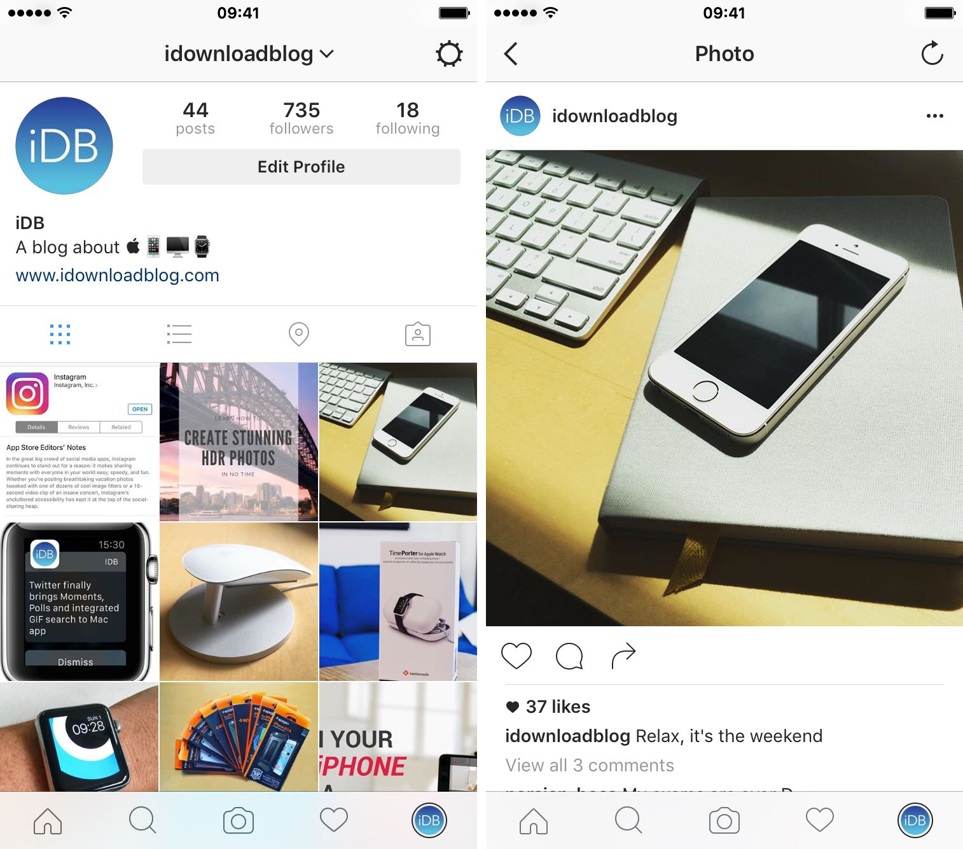
Notes:
How do I use it? (27:08 – 29:35)
You are looking at two images:
The image on the left is an Instagram profile on a mobile device.
The image on the right is of an individual image from someone’s Instagram account on a mobile device
All of Instagram is controlled from the 5-icon menu at the bottom of the app. The icon that looks like a house will navigate you to your News Feed. Just like in Facebook and Twitter, this is where you can see images from everyone that you follow. Instagram only provides you two ways to engage with users’ content. By double tapping on one of your followers’ images, you will send them a like. And if you navigate to the bottom of their post, you also have the option to provide a comment. Outside of these two interaction options, the only other way to communicate with one of your Instagram followers is through sending a direct message – a private conversation option.
The magnifying glass icon is the search menu. When you click this icon you are brought to a search page where you can search for other Instagram accounts and through various hashtags, just like you would do on Twitter! The camera icon is what you would click to add an image or video to Instagram. When this option is clicked, a menu pops up that shows you all of the images and videos that are currently saved on the mobile device you are using. You can either select a photo directly from here, or you have the option to take a picture right on the spot and upload it directly to Instagram! If you are uploading a video, keep in mind that it can only be up to 30 seconds long – so Instagram will give you the option to cut it back if it exceeds 30 seconds.
Once you select the image or video you want to upload, you will be taken to a subsequent page that allows you to add an artistic filter to spruce up the image. After selecting a filter, you can add a caption to go along with the image, and then you are ready to post! Before you post, you can also tell Instagram whether you want to upload your post to your Facebook and Twitter pages as well.
The heart icon on the bottom menu is where you go to check your notifications. Whenever some likes or comments on an image, your heart icon will light up, telling you that a new notification is available!
Finally, the icon on the right of the bottom menu is where you would go to see your own profile. This is the profile for the page you are looking at right now!
Finally, there is one more important thing to talk about as it pertains to your business. If your organization has an Instagram account and a Facebook page, you can connect the two together to make your Instagram account an official Business page. See that gear in the top right corner of the image on the left? That is your settings tab, where you can go to change information in your profile. One option in the settings tab menu says “Switch to Business Account.” By clicking that option, you will be asked to sign in to the Facebook account that is designated as the Admin of your Facebook page. Upon successfully signing in to your account, your Facebook page and Instagram account will now be linked. Switching to a business account allows you to see some basic analytics about your Instagram posts, and allows you to promote your Facebook Ads on Instagram as well!
So now that you have a basic sense of how to use Instagram, lets get in to the pros and cons.

Slide 10
Instagram
  What is Instagram
  Mobile photo-sharing, video-sharing, and social networking service
  Owned by Facebook
  How do I use it?
  Mobile application; upload content that has already been captured OR capture on the spot
  Pros
  Pictures and videos are engaging; Built-in filters to enhance your content; built-in insights and analytics (though not as powerful as Facebook and Twitter)
  Cons
  No desktop posts; News Feed posts use algorithm like Facebook; lack of
  images
http://www.instagram.com
Notes:
Pros (time in video: 29:36 – 30:29)
Instagram is growing at a substantial rate
As we’ve stated earlier, Pictures and video content often get more likes and engagement from your followers
The built in filters allow you to even further enhance your images!
The built in insights and analytics are great, but not as easy to track over time as they are on Twitter and Facebook,
Cons (time in video: 30:30 – 31:53)
No Desktop feature!
Just like Facebook, Instagram uses an algorithm to populate content to your followers’ News Feeds. This is a new feature as of earlier in 2016. Prior to this change, Instagram operated like Twitter, as all the images on your news feed were populated chronologically. Now, it will take you time to build a strong following – but its not too late to get in the game!
It can also be difficult to consistently have great images to share – unless your agency is frequently on the go and generating potential video and image content to share, it may be difficult to consistently update your Instagram account.
Like all other social networks, Instagram can also be time consuming to build and gain a following. However, Instagram has become very popular with younger audiences. If your agency would like to try new engaging ways to reach youth, Instagram is definitely a great place to start
Facebook, Twitter, and Instagram have become some of today’s most popular social media platforms – both for personal use and for organizations to connect with their communities. In addition to these platforms, there are others that an organization like yours may consider using. In the next few slides, we are going to discuss some of the basics of these platforms. First, lets talk about YouTube…

Slide 11
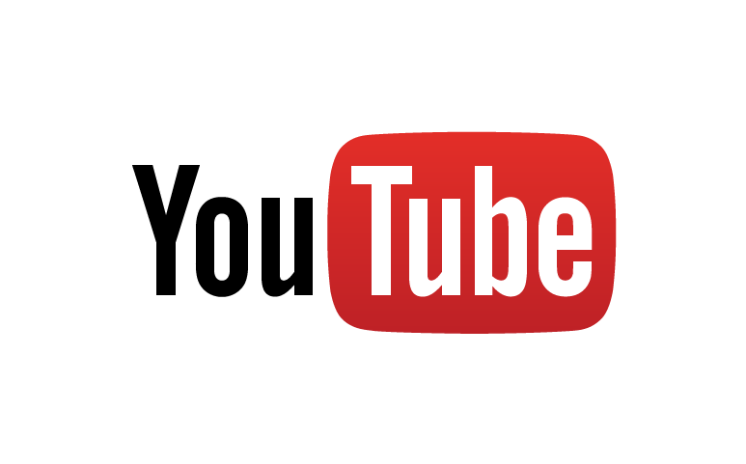
YouTube
  What is YouTube?
  The largest free video sharing website in the world
  How do I use it?
  Creating and uploading videos; discovering other useful resources
  Pros
  Videos = most engaging content on web; leverage videos through other social media platforms; Analytics!
  Cons
  Time consuming; specialized skills or resources needed
http://www.youtube.com
Notes:
YouTube: 31:54 – 34:52
What is YouTube (31:54-32:35)
YouTube has over 1 billion users. Everyday there are over 100 million hours of video content watched and over 1 billion content views.
This platform is a free video sharing website that makes it easy to watch online videos anywhere. You can even create and upload your own videos to share with others.
If you've ever watched a video online, there's a good chance it was a YouTube video. When you search for videos on Google, the videos that appear in the search browser are all from YouTube. Additionally, when you are reading articles from your favorite news sources, any videos embedded on those pages are also likely coming from YouTube. In fact, you are currently watching this video on YouTube!
This goes to show that while you may not actively be visiting YouTube, it is definitely the easiest and most popular way to upload and share video content.
How do I use it? (time in video: 32:36 – 33:35)
In order to create a YouTube account, you must first have a Gmail account. Once your account has been created, it becomes your personal profile, known as your “Channel”, for uploading video content. Users who are active on YouTube can visit your YouTube Channel to see all of the videos that you have uploaded, sorted either by most recent uploads, or by most popular videos.
No matter where you are in the YouTube website, you will always see a button that says “Upload” in the top right corner of the menu. Once you navigate to this you can select or drag one or several video files from your desktop to be uploaded to your Channel. As the video is uploading, you are taken to a page where you can provide a description about your video, and determine whether you want it to be public, unlisted, or private. Unlisted allows your to share your video with others through a direct link, while private makes your video invisible to anyone who isn’t logged in to your account. When the video is fully uploaded you can click Done, and then you are good to go!
Pros (time in video: 33:36 – 34:19)
Using YouTube has several pros:
Videos are the most engaging content you can post online – so an engaging video has a higher chance of being consumed by community members, than a text or image post.
You can use other platforms like Facebook, Twitter, and your website to leverage YouTube content. Because YouTube isn’t as viral as these platforms can be, you will want to take advantage of your other platforms for promoting your video content.
YouTube provides you with analytics about how many views your videos have, as well as the duration that people spend watching your videos. So you can find out how engaging your videos really are.
Cons (time in video: 34:20 – 34:52)
As for cons, there aren’t many in the realm of reasons why not to use YouTube. They simply boil down to skills and resources. For instance:
Creating and editing video content can be VERY Time consuming
Filming and editing also typically requires specialized skills & training. If you do not have someone on staff who can film and edit video, you may need to consult with an external organization to help film and produce a video – and this can be an expensive endeavor.
Now lets talk about Snapchat…

Slide 12

Snapchat
  What is Snapchat?
  Snapchat lets you share images or video clips with your friends
  Post to your “story” for 24 hours or send directly for a 1-time view – up to 10 seconds
  How do you use it?
  Can only be used on mobile
  Snap code for friends
  Pros
  Filters; Geofilters; Lenses / Face swap; Drawing; Text
  Cons
  Content disappears; no analysis options; difficult to build a following
http://www.snapchat.com
Notes:
Snapchat: 34:53 – 38:37
What is Snapchat? (time in video: 34:53 – 32:35):
Snapchat is a newer social media platform that is continuing to grow and find its niche. Snapchats 200 million active users, are able to capture and send images and videos directly to select friends – these are called “Snaps.” Snaps can range from 1-10 seconds and will disappear immediately after being viewed. OR you can post a Snap to your “Snap Story” where it will remain for 24-hours for all of your Snapchat followers to see.
Snapchat is very unique in comparison to all of the other social media channels, and it can be very challenging for businesses to build a following. As a business, you must share your unique snap ID on Facebook, Twitter, and Instagram in order for your followers to notice. And unlike these other platforms, there is no profile for you to build where your images and videos can be saved over time. After the 24-hour period of your Snap Story has passed, it disappears, with no way of your users being able to see it again. Regardless, it is becoming a new trend for people and organizations to share their experiences with their friends.
Lets get in to how to use snapchat!

Slide 13
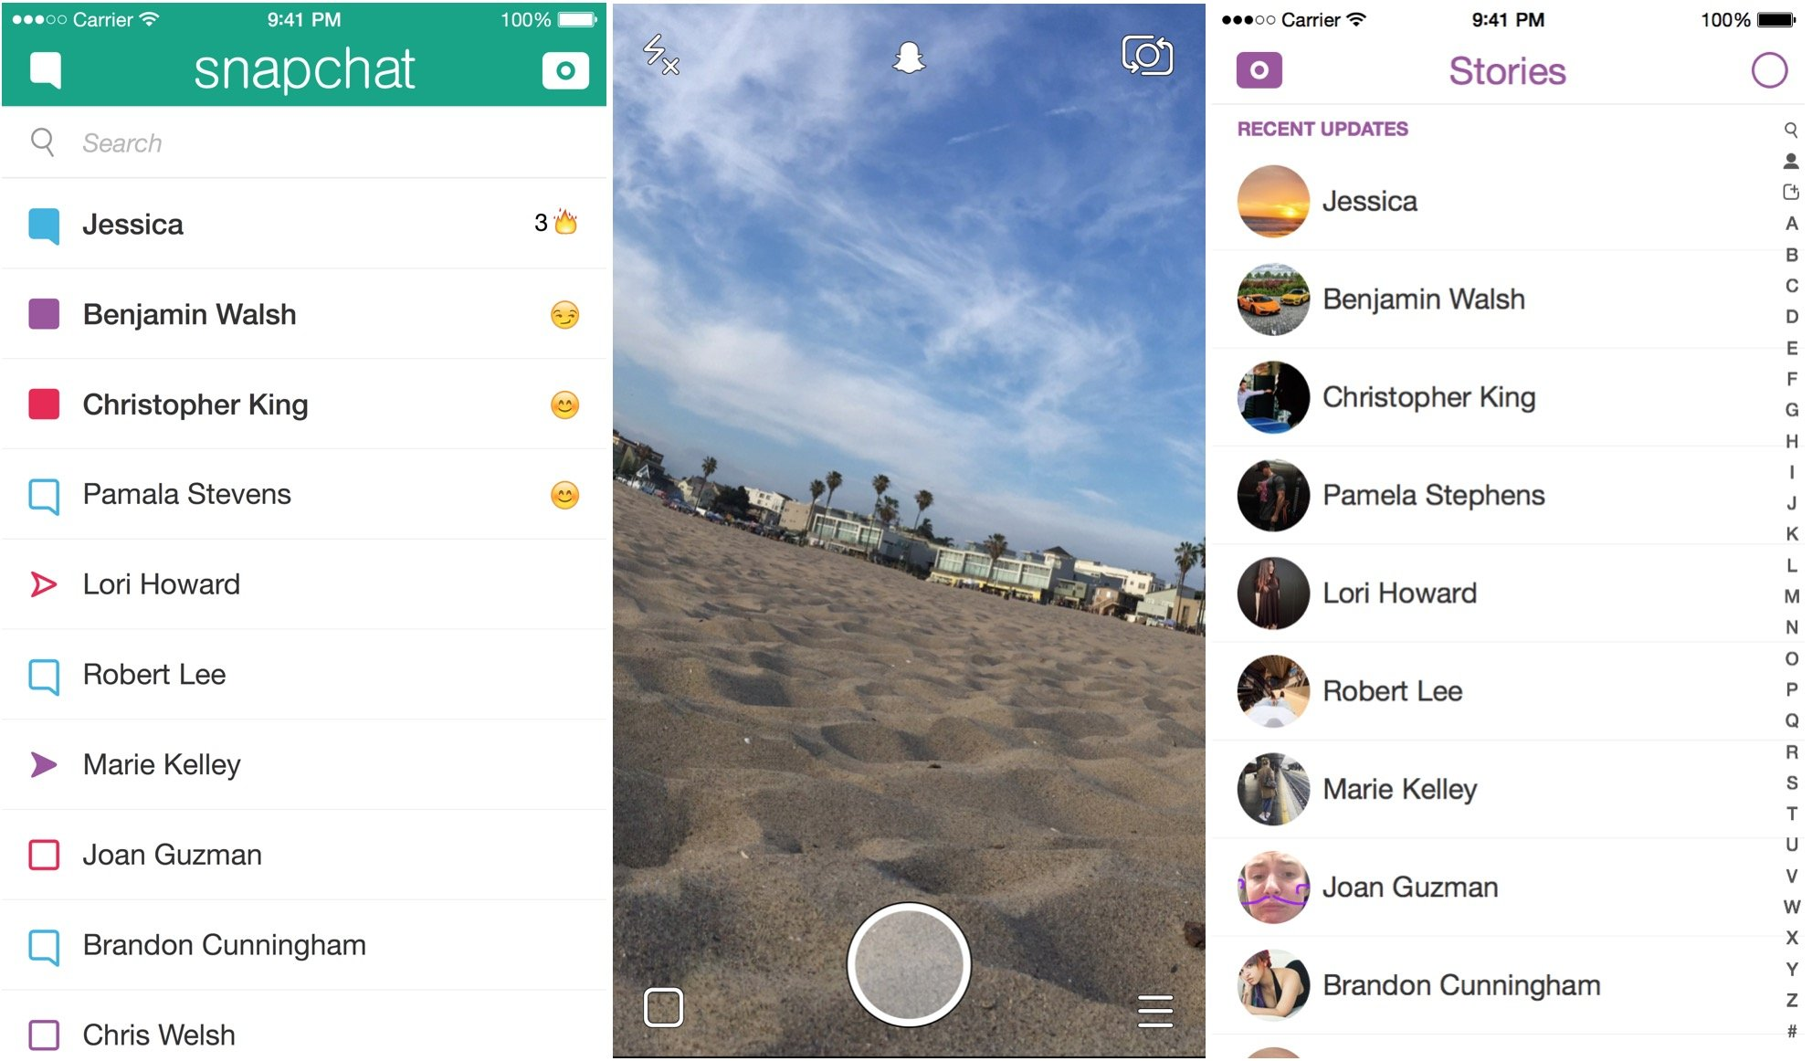
Notes:
(time in video: 36:07 – 37:08)
How to use Snapchat:
Just like Instagram, Snapchat can only be used on a mobile device. The three images on this slide demonstrate Snapchat’s layout. When you open the application, it will open up to the camera on your smartphone device.
The large icon circled in green at the bottom of this screen is what you press to take your snap. Tap this button to take a picture. OR if you hold it down, you can take a video up to 10 seconds – release the button when your video is complete. Once you’ve taken a picture or video, you can touch up your snap by adding fun filters, text, or emoji stickers to it!
Once you have finished editing your snap, you can chose to send your snap directly to specific followers (as many as you want), or you can click “My Story” which will post it for all your followers to see. For organizational use, you will mostly just be posting snaps to your story.
Finally, the left image on this slide is your own personal snapchat feed. This is where you go to check new snaps that have been sent directly to you. The shapes colored in mean that the snaps have not yet been viewed, while those that have no color filled in have already been viewed.
Now that you know the basics of using snapchat, you might have picked up on some obvious pros and cons. So lets talk through them.

Slide 14
Snapchat
http://www.snapchat.com
  What is Snapchat?
  Snapchat lets you share images or video clips to your friends
  Post to your “story” for 24 hours or send directly for a 1-time view – up to 10 seconds
  How do you use it?
  Can only be used on mobile
  Snapcode for friends
  Pros
  Photo editing; geo-filters for events; Heavily used by younger audiences
  Cons
  Snaps disappear; difficult to build a following; no analytics
Notes:
Pros (time in video: 37:09 – 37:41)
Snapchat offers several pros to organizations considering its use:
First, the photo editing capabilities are creative and engaging ways to entertain your Snapchat friends.
Second, You can create geo-filters for your organizations events. This allows people who are attending your event to add a filter to their snaps to let their followers know where they are.
Finally, snapchat continues to grow, especially within younger age demographics. If your organization works with a lot of youth, then using snapchat can be a great way to connect with them and share updates about your events.
Cons (time in video: 37:42 - 38:37):
Now, lets talk about some of Snapchats cons:
The obvious con with snapchat is that your Snaps disappear, so there is no way to really follow what you have been doing over time
Second, building a snapchat following for your organization can be very tough! It is hard to get noticed and users have to actively find you.
Finally, Snapchat does not provide you with any analytics, so you have no way to tell how much activity and engagement your snaps are receiving..
As a consumer of social media, I love using my own personal Snapchat to interact with my friends. As a social media marketer, I have struggled to find the value for many organizations that don’t already have a strong following on their other platforms first.
Now, lets talk about Pinterest…

Slide 15

Pinterest
http://www.pinterest.com
  What is Pinterest?
  Upload, save, sort, and manage content – known as pins – that is of interest to you.
  “The world’s catalog of ideas” – each pin is an idea
  How do I use it?
  All it takes is a picture and a link!
  You can search other users’ content and re-pin it to your own page
  Pros
  Organize content by various topics – “boards”; Pins last longer than tweets or Facebook posts; Analytics included; can help you gather resources
  Cons
  Specific audience; content can become jumbled; Not geared for all types of content
Notes:
Pinterest (38:37 – 42:18)
What is Pinterest? (38:37 – 39:59)
Pinterest is a social media platform known for being “the world’s catalog of ideas.” It allows its users to upload, save, sort, and manage content of interest that is available on the web. These uploads are referred to as “Pins.”
Pinterest is a notable platform to cover because of its recent surge in growth. In the last year, Pinterest has increased its active users by 50%, from 100 to 150 million. While Pinterest was originally focused on personal use, it has continued to evolve and become more geared for organizations to share creative content.
What makes Pinterest’s cataloging aspect unique is your ability to create what is known as a “Board.” A board is where you can gather countless pins as they relate to a specific topic. As an organization on Pinterest, you can create boards for internal or external use. An internal board might be created for you to store resources that you come across that may be helpful to you and others within your organization. Externally, you can create boards to share content your organization produces. For example, The Improve Group has a board that we have created for all of our blog posts. So when one of our followers goes to the IG blog board, they can easily scroll through and see all of our blog posts in one clean, and visually appealing page. You can create as many boards as you would like on Pinterest, and they can serve whatever purpose you’d like. You may create a board for one of your events, or for a specific topic your organization specializes in.
So How does it work? (time in video: 40:00 – 40:38)
Pinterest is a very easy to platform to use. You can either share a pin from another user on Pinterest or you can create your own. When you chose to share a pin from another user, you can simply select the board that it fits best with and click share – you’re good to go! If you want to create your own Pin, you can navigate to your own profile and click “Share Pin.” Then all you need is a link! You can copy and paste the link to the page you want to share, select an image from the page to go along with it, and add a description. Save it to the appropriate board and you are good to go!
So lets go through some of the pros and cons:
Pros (time in video: 40:38 – 41:21)
There are several pros to using Pinterest for you business:
As I said earlier, Pinterest grew by 50% in the last year. If that trend continues, we could see Pinterest becoming one of the more prominent social media platforms in the future.
Second, Pinterest is a great way for you to sort your content and resources in a clean, visually appealing format.
Third, the lifetime of a pin is much longer than a Tweet or Facebook post. Thanks to the organizational features of your boards – users who follow you can easily find your content months after it has been posted.
Finally, Pinterest offers in depth analytics just like Facebook and Twitter do. So if you decide that you want to start using Pinterest, you can begin tracking your activities right away!
Cons (Time in video: 41:21 – 42:18)
While Pinterest has its pros, there are also cons that come with it as well:
First, the demographics of Pinterest users is pretty specific. Over 70% of users are women aged 18-45. Additionally, over 50% of its users are based outside of the U.S. So if your goal is to reach men in the geographical region you serve, may not have much success.
Second, content can get easily jumbled on Pinterest. There are over 10 billion Pins made per day. With numbers like that, it can easy for your Pins to get lost in the mix.
Finally, pins must be accompanied with an image. If your organization does not often have images to accompany your resources, you may find it difficult to frequently generate a Pin. And as is a common theme on these more creative platforms – creating this content can just be time consuming.
Now that you know more about Pinterest, lets talk Live Streaming platforms

Slide 16
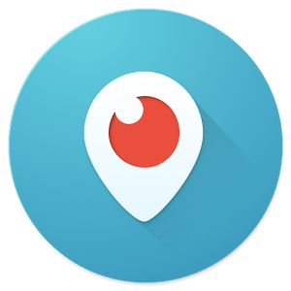

Facebook Live / Periscope
  Live Video Streaming
  Broadcast any event live on the spot for your audience to see
  How do I use it?
  Facebook Live is built into Facebook – need “Pages” app for business
  Periscope is mobile app, but it is powered by Twitter
  Pros
  Followers notified; can engage with you on the spot; still very new
  Cons
  Network can be spotty; audio & video quality may be low; mistakes cannot be controlled
Notes:
Live Video Streaming (42:19 – 46:26)
What is Facebook Live / Periscope? (42:19 – 43:00)
Live Video Streaming is one of the newest trends in the social media industry, but in the last year and a half it has begun to break on to the scene. Live video streaming allows you to broadcast any event live for your audience to see, whether you are on Facebook, Twitter, or YouTube.
Facebook has integrated the “Live” feature directly in to its application. Periscope is now powered by Twitter, bringing your live stream directly to your Twitter Timeline, and in recent months YouTube has been building its own Live Stream beta. All over the internet, people are taking to the web to show their friends and followers what they are doing right on the spot.
How to go live (time in video: 43:01 – 43:51)
In order to go live, you need to be using a mobile device. There are two ways to go live on Facebook – either live from your personal profile or through your company page. To go live on your personal Facebook profile, you first need to download the Facebook application on your smartphone. To go live from your organization’s Page you need the Facebook Pages app. From the home page of these apps, you can tap the “Go Live” button and just like that your followers will be notified.
For Twitter, you need to use the Periscope app. Download the app, and connect it to your Twitter account. From there, click the camera button at the bottom menu of the app and then you are good to go Live! The stream will then feed directly into your Twitter timeline.
Why go live? (43:51 – 44:23)
(From an organizational stand point, going live can be used in several ways. You might hold a Q&A session, where people can ask you questions about some of the issues your agency is dealing with. Additionally, you may chose to go live at one of your community events, either during a keynote or presentation or perhaps during one of the event’s activities. Those who are not present at your event can then tune in and see what is going on right on the spot! Once your stream has ended it will save to your page or Timeline automatically so that users can go back and view at any time!
While live streaming is still a new social media tool, there are some pros and cons that we have noticed with this these services thus far…
For Pros (44:24 – 45:11):
Your followers are notified when you are going live. As soon as you press “Go Live”, a notification is sent directly to the people who like your page telling them that you are going live. This is a unique way to attract and engage people
Another pro is that people who are viewing your video can engage with you right on the spot! They can like your video and they can even post comments to ask questions.
One of the other pros that we see with Live streaming is that it is still so new, you have an opportunity to become one of the early adopters of these services, which can position you to gain a strong following.
Cons (45:12 – 46:26):
Of course, these pros are also accompanied with some cons that we’ve experienced first hand.
For one, the Network that you are using needs to be high quality; If your internet connection is spotty, then your video and audio quality can suffer, and the people who are viewing your stream might become upset.
The other con of Live streaming is that it is Live and therefore you cannot control for any mistakes and miscues. Luckily, your users know that this recording is live, and will hopefully not get too worked up if something unexpected happens along the way.
The last platform that I want to cover is LinkedIn

Slide 17

LinkedIn
http://www.linkedin.com
  What is LinkedIn?
  LinkedIn is a social media site designed specifically for the business community
  Allows you to build and strengthen your network of colleagues, classmates, friends, and family
  How do I use it?
  Personal page is a lot like a digital resume
  Business page is geared towards helping you share content and promote your business
  Pros
  Build SEO & Credibility for your business; Stay up to date on news in your industry; Find and connect with others in your industry
  Cons
  Only paid versions provide advanced analytics; may be difficult to reach your intended audience
Notes:
LinkedIn (46:28 – 49:07)
What is LinkedIn? (46:28 – 47:00)
LinkedIn is a social network built for the professional community. The purpose of this platform is to build your own digital resume and professional profile to help strengthen your network of colleagues, classmates, friends, and family. In addition to building your own personal profile, LinkedIn also offers business the abilities to create pages as well. However, these pages are mostly focused on workforce development – demonstrating why your org would be an awesome place to work and attracting new people to your workforce.
How to use it? (47:00 – 47:49)
Just like Facebook, in order to create a LinkedIn page for your organization, you must first have a personal account. When you go to make a profile on LinkedIn, you are walked through a step-by-step process of providing past career information, such as your employment history, educational experience, and more. It is a lot like building a resume, and in fact, it would be very helpful to have a resume handy when you complete this process. You can then begin to connect with all of your colleagues in the professional field.
Once you have an account on LinkedIn, you can create a page for your organization. Once you have a company page created, it operates a lot like your Facebook company page. You can appoint Admin roles to other LinkedIn users who work for your organization. And you can post directly to your company page! These posts will then show up on the news feeds of those who Follow your company.
Pros (47:50 – 48:22):
There are several pros to using LinkedIn for your organizations.:
For one, a strong LinkedIn page can show that your organization is credible and that your resources should be trusted; It can also attract new people to your organization that may not have known about it previously!
LinkedIn can also be a great place to connect with others who work in your industry – because most states have organizations that do work similar to yours, you can use LinkedIn as a means of finding others who do work similar work and connect with them. This can be a great opportunity to work together and learn from each other.
Cons (48:23 – 49:07)
LinkedIn also has its Cons for organizational use:
For example, unless you are trying to reach business professionals with your content, then LinkedIn is not the most efficient space to share resources from your organization and get the results that you are hoping for.
Additionally, LinkedIn provides some basic features and analytics for free; but you need to pay to see advanced analytics about who is viewing your company page. And the prices for a paid LinkedIn account can be very high!
An organization would mostly used LinkedIn to attract new people to its workforce and to share resources that promote why the organization is great to work for. So while LinkedIn may not be the best resource to reach your stakeholders with your programming, it can still serve as a platform to help further build your organization as a whole – through the connections that you make.

Slide 18
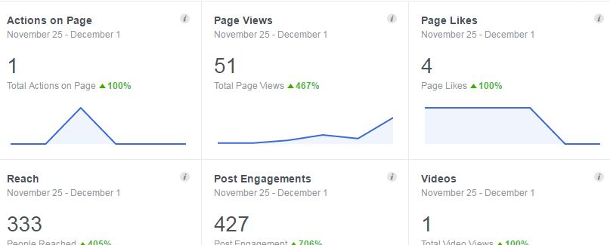
Social Media for Analysis
While all tools have their specific instances of use, only few of them are geared towards being analyzed.
Notes:
(49:04 – 49:46)
As I've mentioned earlier, only certain social media platforms provide the necessary analytics to track your activity over a period of time. We believe that Facebook and Twitter provide the best opportunity to do analysis on your social media efforts. Part 2 of this training will focus on how you can analyze your posts on Facebook and Twitter moving forward.
However, just because the other channels do not provide as strong of analytics, does not mean they should be written-off. Through this training we hope you get a better understanding of what the other platforms are, how they are intended to be used, and who you can reach through each platform. We hope this information will help your organization make a decision on which channels are applicable for your audience.

Slide 19

Tools for Optimization
tools that will help you schedule posts across multiple platforms in one place
Notes:
(49:46 – 59:59)
Before we conclude our training on the basics of Social Media, and move on to Using analytics in social media, I want to highlight a useful tool to stay more connected through social media, and better engage and grow your social media following.

Slide 20


Buffer & Hootsuite
  What are Buffer and Hootsuite?
  Social Media optimization tools – not new, unique Social Media platforms
  Give ability to curate and schedule your social media posts in one place – 1 month in advance!
  How do I use it?
  Create account and connect your various Social Media accounts – Facebook, Twitter, LinkedIn, Instagram
  Draft your post and copy in to Buffer or Hootsuite platform; select which Social Media platforms your post will go to and when.
  Pros:
  Sync multiple accounts and work in one setting; schedule posts in advance; schedule posts during events; provides built-in analytics
  Cons
  Free version limits amount of posts you can schedule; Not as much customization within posts
http://www.buffer.com
https://hootsuite.com/
Notes:
Buffer & Hootsuite (50:00 – 53:01)
What are Buffer & Hootsuite? (50:00 – 50:58)
Buffer and Hootsuite are two different platforms that allow you to optimize your social media posts. Each platform provides similar services, and they both have one goal: to manage your social media accounts and give you the ability to curate and schedule your posts in one place! Having a tool to optimize your social media content is one of the most effective ways to ensure you are sticking to your social media plan.
In part 3 of this training, we will work through the development of a social media plan for an upcoming event, and in the process you will learn about the usefulness of creating posts up to a month in advance. Once your posts and tweets have been planned, you can upload them right to Buffer or Hootsuite in minutes, designate when you want those posts to go out, and then click Schedule! Now your social media posts are all prepped and ready to go a month in advance – allowing you to focus on the other aspects of planning your event.
How do I use them? (50:58 – 52:15)
Creating an account for either platform is simple and easy – you can either use an email address, or sign in directly to your Facebook or Twitter account. Once your account is created, you have the option to sign in to Twitter, Facebook, LinkedIn, and Instagram. The beauty of connecting multiple platforms is that you can schedule one post to shoot out to all four of these platforms at the same time.
As you continue to use Buffer and Hootsuite, they use the data to suggest when your followers are most likely to be online. Based on this, the platform will generate the best times for you to post your updates throughout each day of the week, ensuring you reach the most people you possibly can at that time.
Finally, the other great part about using these platforms is that they provide unique click and engagement analytics for every post that you send out. The analytics are not as in depth as they are on Facebook and Twitter, but they do act as a good resource for seeing how your posts are performing on the spot and across platforms.
Both these services are free to use! Buffer and Hootsuite do provide paid versions as well, which include more analytics, the ability to connect your Pinterest account, AND the ability to schedule more than 20 posts at a time. The free versions should definitely suffice for you at the start, but you may want to consider a paid version if you feel those added services would be of benefit to you.
Pros (time in video: 52:16 – 53:01):
In summary, these two platforms are very simple to use, and the process of crafting your tweets and posts looks almost identical to doing them in the actual platform. They provide the following benefits:
You can Sync multiple accounts so that you don’t have to jump around from platform to platform when creating and sending posts
You can Schedule your social media posts up to a month in advance so that you don’t have to worry about posting throughout the weeks and months leading up to your events
You can Schedule posts to go out DURING an event when your resources are stretched
Finally, you can track engagement for each of your posts, such as clicks, comments, likes, etc.
While we don’t have a preference for one of the other, we definitely recommend using one of these very useful tools!

Slide 21
End of Part 1
Notes:
(53:01 – 53:23)
Thank you for joining us for Part 1 of our training on Social Media analysis. We hope that through this session you were able to get a better understanding of the social media platforms that are out there, how they can be used, and the pros and cons of using them for your organization.
In the next part of this training, we are going to talk about how to analyze your social media results on Facebook and Twitter.

